Slide 1
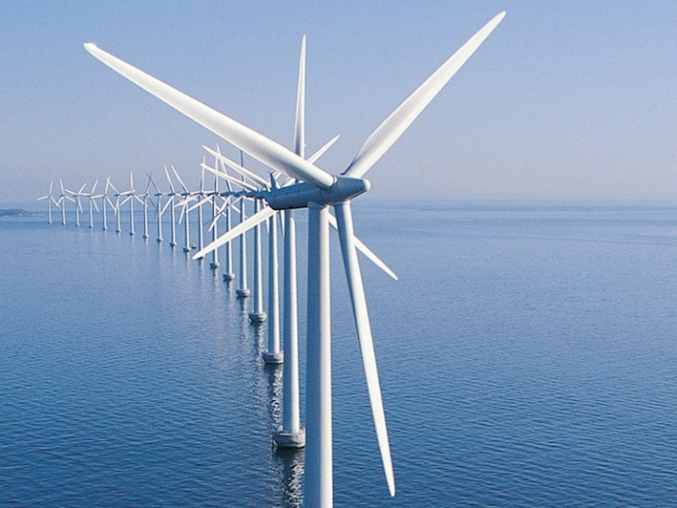
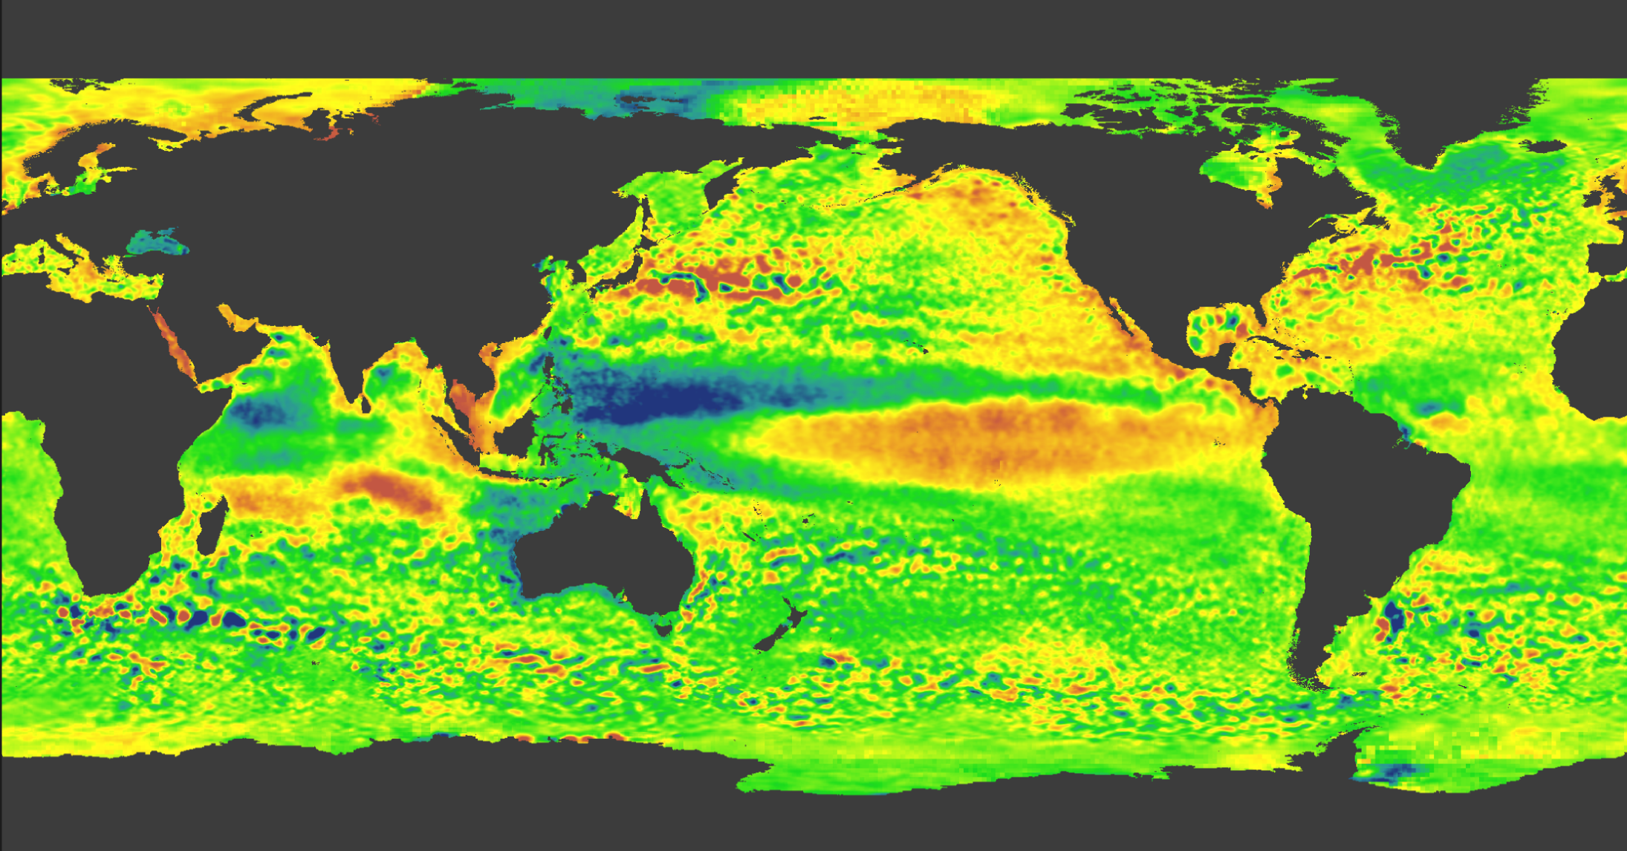
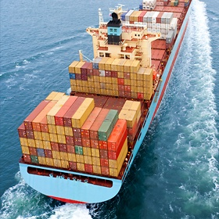
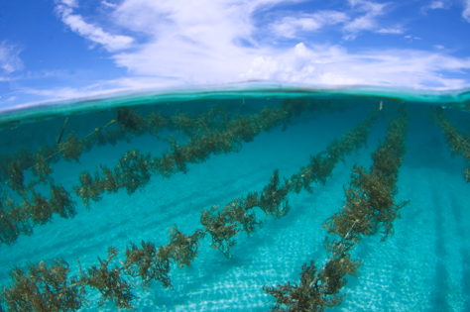
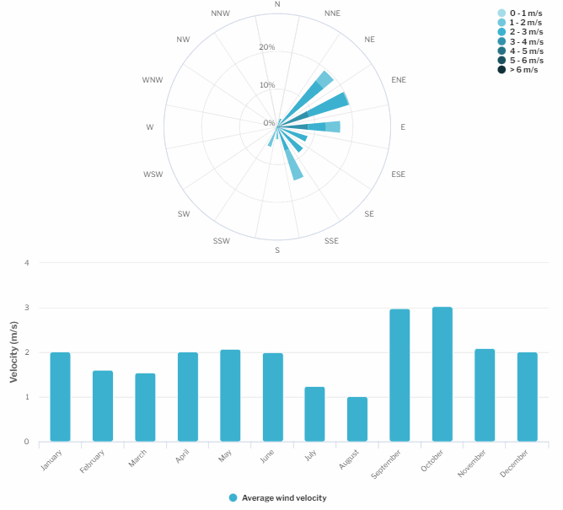
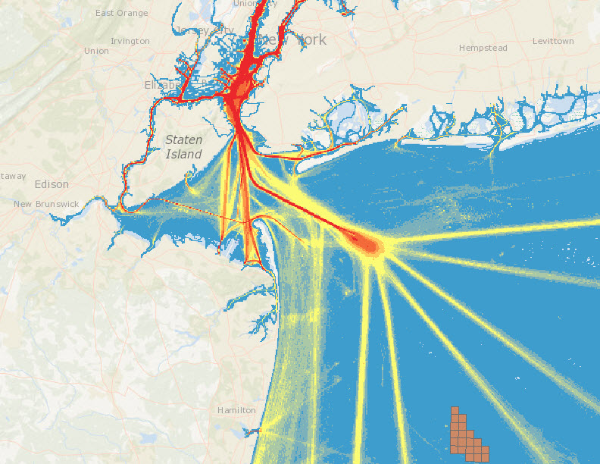

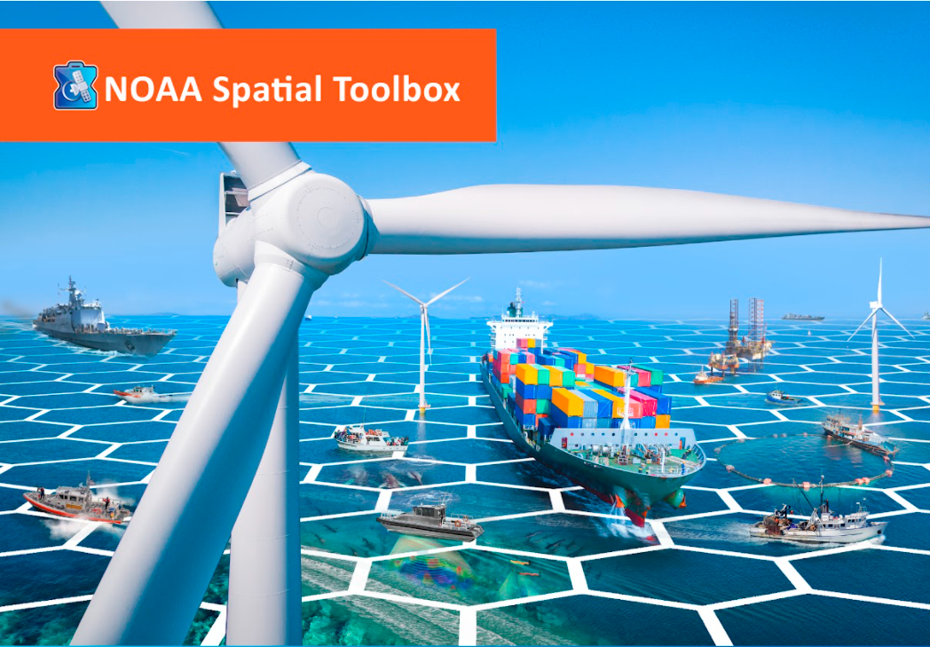

Gulf of Maine Cable Routing - Stellwagen Bank
NOAA OSW Spatial Team
James.Morris@noaa.gov

Slide 2
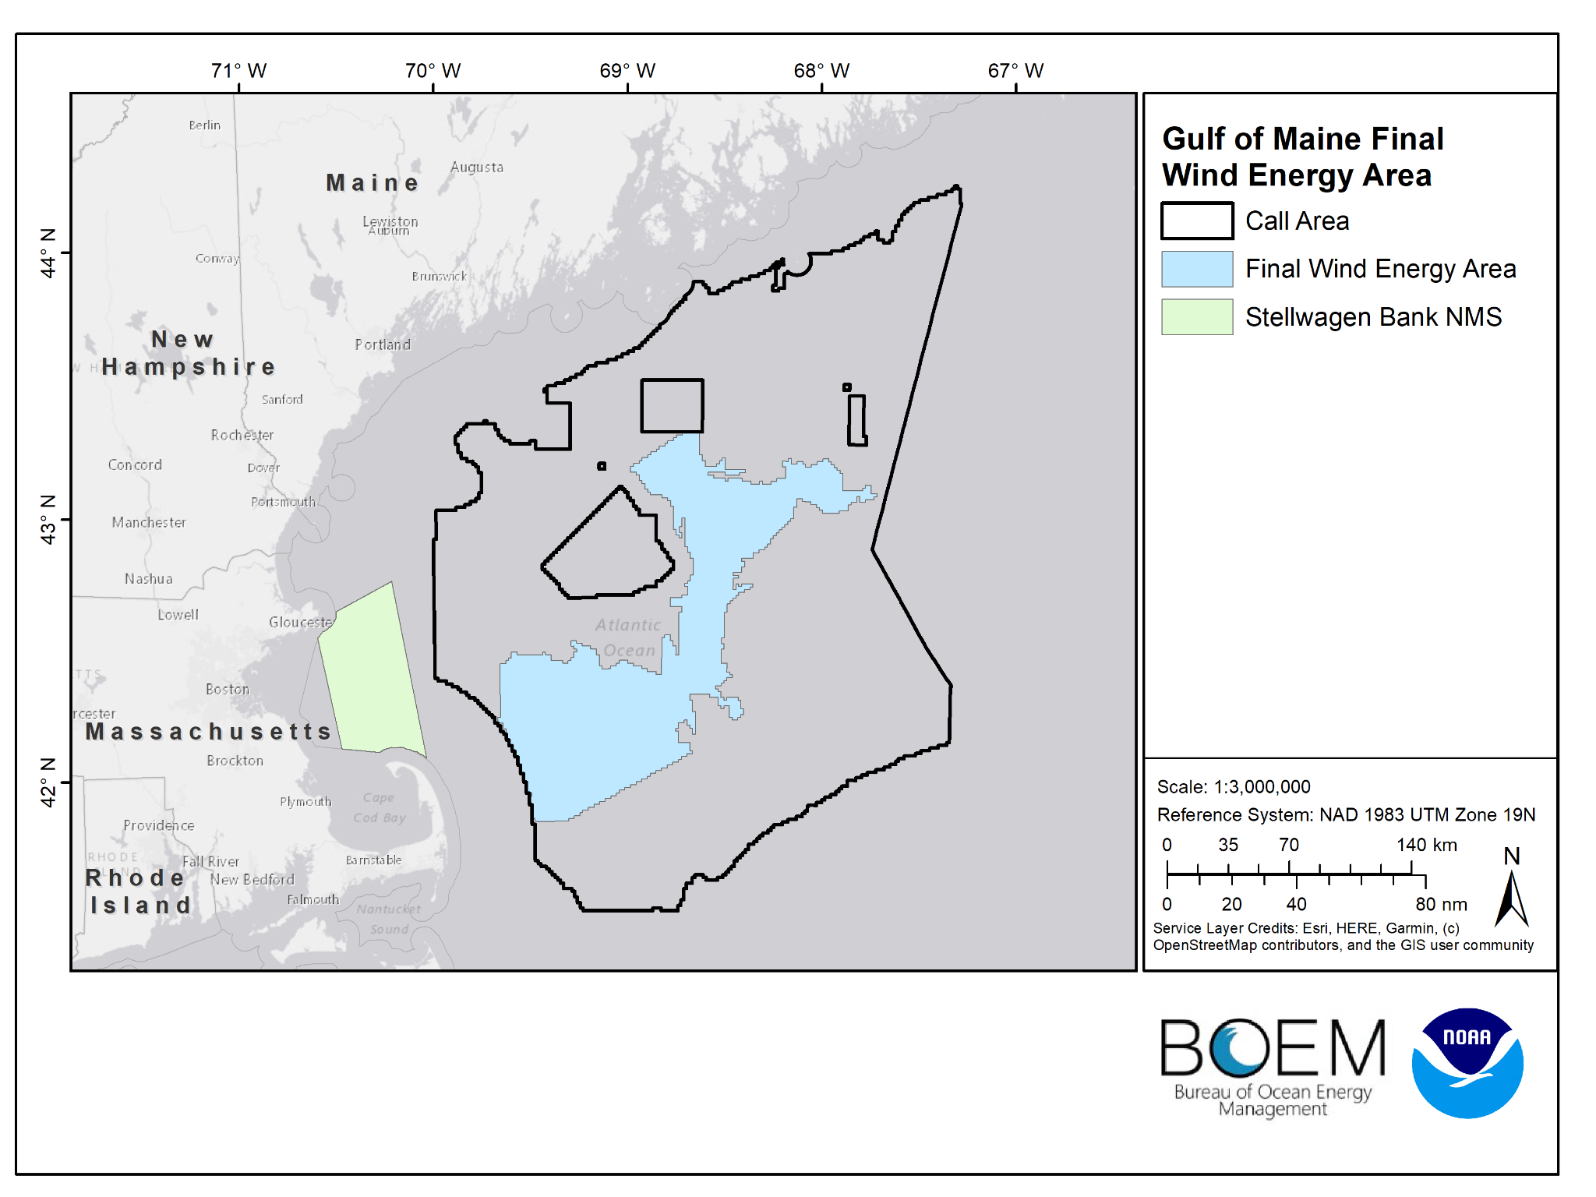
Final Wind Energy Area

Slide 3
Next Iterations
2 - 3 corridors (Mainly one in the northern portion)
1,000 m and 500 m wide corridors
Remove Sand Lance sites
Notes:
So this data inventory will be developed and updated as outreach and engagement continues with stakeholders.

Slide 4
Agenda
Introductions
Recap Last Meeting
NMS - Data Inventory
Cable Routing Draft Run
Discuss changes, data, scoring, other ideas, etc
Next Steps

Slide 5
Previously on…
NCCOS received a well organized NMS geodatabase
Any update on USCG about cable routing through TSS
NCCOS will work on acquiring Updated VMS data (It turns out BOEM has 2014-2021 VMS data for the area, just need approval from OLE)
At this time we decided to model cable routes through Stellwagen only, and not through State Waters / Federal Waters
Notes:
The starting basis for our data inventory is our Gulf of Maine MSP Database, which includes 463 data layers from different sectors. We will need to collect additional data from state/local engagement including state waters and certain land-based data.
So this data inventory will be developed and updated as outreach and engagement continues with stakeholders.

Slide 6
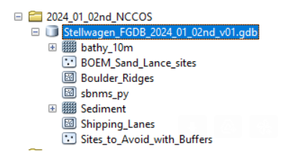
NMS Geodatabase
Notes:
The starting basis for our data inventory is our Gulf of Maine MSP Database, which includes 463 data layers from different sectors. We will need to collect additional data from state/local engagement including state waters and certain land-based data.
So this data inventory will be developed and updated as outreach and engagement continues with stakeholders.

Slide 7
Constraint Data sets
Constraint Data sets | Score
Sites to Avoid (1000-m setback) | 0
Boulder Ridges (500-m setback) | 0
Existing Submarine Cables (1000-m setback) | 0
Sediment Classification (Boulder) 500-m setback | 0
*Note recommended setback distances include an additional 500-m to account for a 1-km cable corridor, LCP analysis identities a line, which is then given a 500-m setback
Notes:
The starting basis for our data inventory is our Gulf of Maine MSP Database, which includes 463 data layers from different sectors. We will need to collect additional data from state/local engagement including state waters and certain land-based data.
So this data inventory will be developed and updated as outreach and engagement continues with stakeholders.

Slide 8
Cost Data Sets
Cost Data sets | Score
Sand Lance Sites (600-m) | 0.5
Slope (Flatter is better) | Linear Function
Sediment Classification (Gravel)* | 0.5
*Assumes Mud/Sand is the preferred habitat for a cable, may not be true?
Notes:
The starting basis for our data inventory is our Gulf of Maine MSP Database, which includes 463 data layers from different sectors. We will need to collect additional data from state/local engagement including state waters and certain land-based data.
So this data inventory will be developed and updated as outreach and engagement continues with stakeholders.

Slide 9
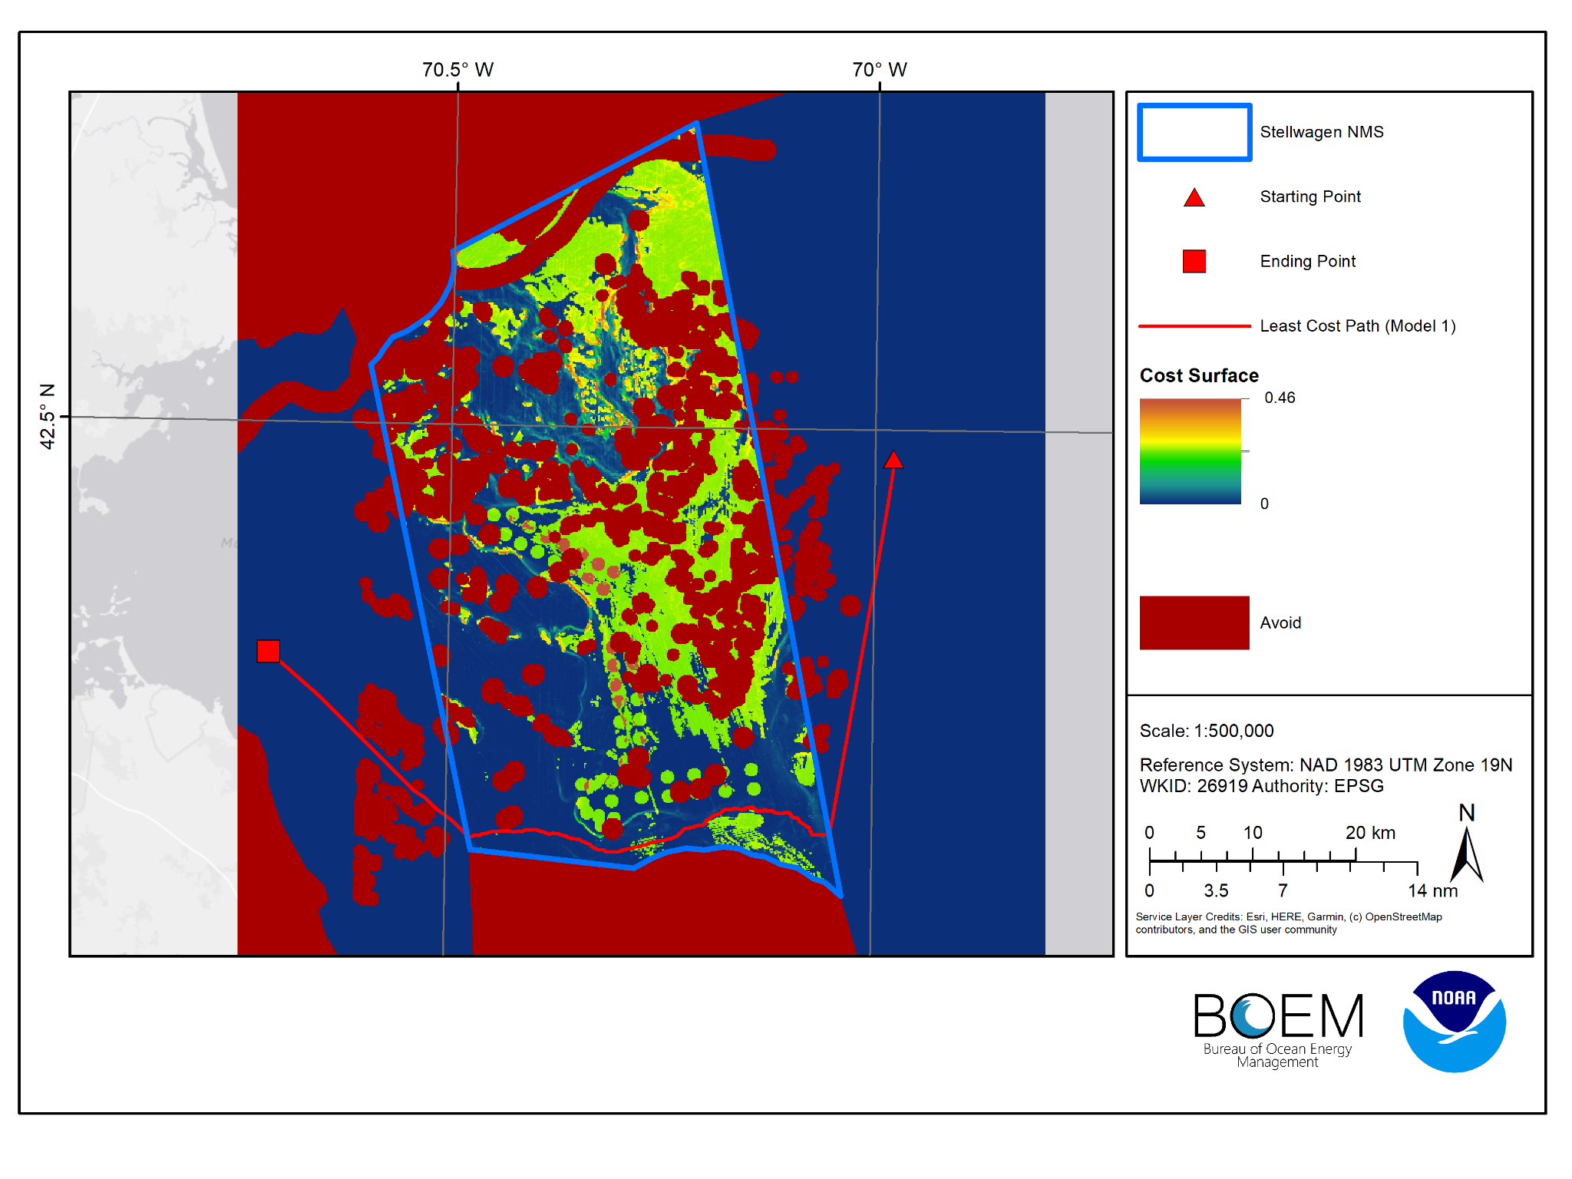
Model Results
Notes:
The starting basis for our data inventory is our Gulf of Maine MSP Database, which includes 463 data layers from different sectors. We will need to collect additional data from state/local engagement including state waters and certain land-based data.
So this data inventory will be developed and updated as outreach and engagement continues with stakeholders.

Slide 10
Additional Data to Consider?
Protected Species?
Other Habitats? (Bank?)
Sediment Grain Size?
Slope Constraint? (Any area with a slope > 10°)
Shipping Lanes?
Fisheries data?
Hardbottom constraint?
Notes:
The starting basis for our data inventory is our Gulf of Maine MSP Database, which includes 463 data layers from different sectors. We will need to collect additional data from state/local engagement including state waters and certain land-based data.
So this data inventory will be developed and updated as outreach and engagement continues with stakeholders.

Slide 11
Next Steps:
Continue to refine and search for data sets
Work to develop additional modeling scenarios
Continue literature review to inform model parameters
Contact reach out to cable routing industry experts
Follow up meeting?

